Slide 1

Unit 5: Lesson 1
Should I stay or should I go

Slide 3
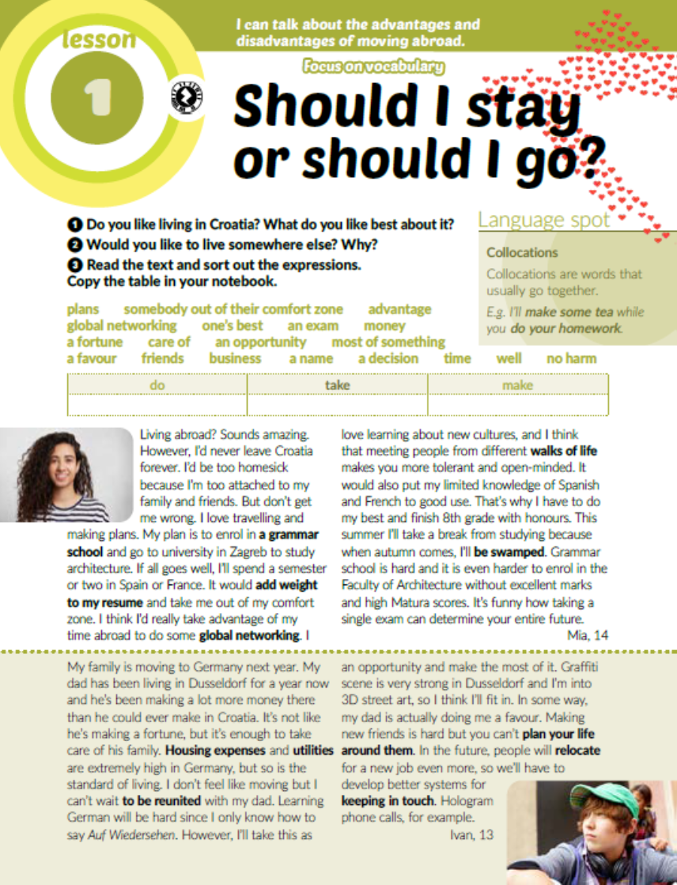
Task 3: Read the text and sort out the expressions.
DO | TAKE | MAKE
global networking one’s best a favour business well no harm | somebody out of their comfort zone advantage an exam care of an opportunity time | plans money a fortune most of something friends a name a decision

Slide 4
Task 4: Read the text again and figure out the meaning of the words and expressions written in bold.
grammar school = gimnazija
to add weight to a resume = poboljšati životopis
global networking = ostvariti kontakt s ljudima iz različitih
zemalja i dijelova svijeta s ciljem poslovne suradnje
walks of life = životne okolnosti
to be swamped = biti u poslu to grla
housing expenses = troškovi stanovanja
utilities = režije
to be reunited = ponovno se sastati
to plan one’s life around somebody = planirati važne životne odluke
imajući u vidu određenu osobu
to relocate = preseliti
to keep in touch = ostati u kontaktu
a vocational school = strukovna škola
to meet one’s expectations = ostvariti nečija očekivanja
there’s room for improvement = postoji mjesto za poboljšanje
to sugar-coat = ublažiti

Slide 5
Task 5: Write an interview with Mia, Ivan or Jana using the following questions.

Slide 6
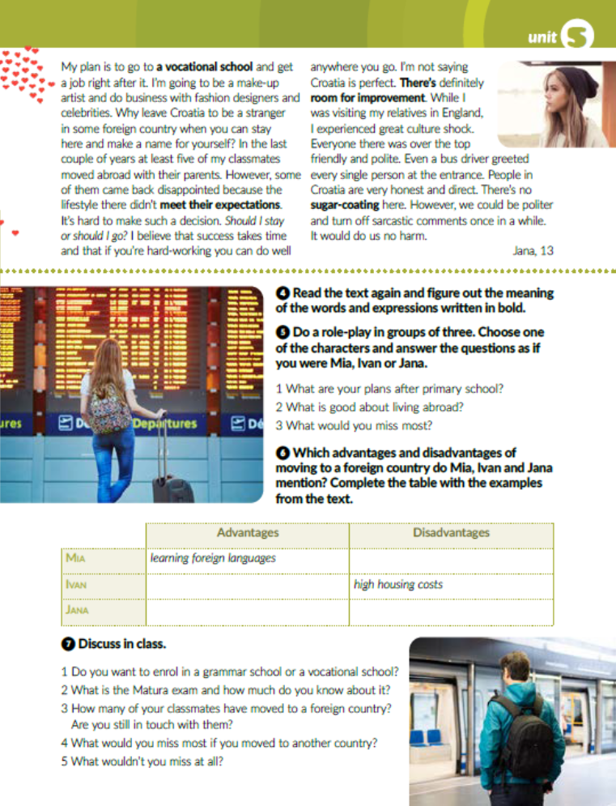
Task 6: Which advantages and disadvantages of moving to a foreign country do Mia, Ivan and Jana mention?
Complete the table with the examples from the text.
be homesick and miss family and friends
make more money
high standard of living
honest and direct people
being a stranger in a foreign country

Slide 7

Task 7: Answer the questions.

Slide 8
workbook, page 87
Task 1: Circle the correct option.

Slide 9
Task 2: Complete the sentences with the words from the box.
decision
business
plans
money
advantage
care
opportunity
favour

Slide 10
Task 3: Match the words/expressions and the definitions.
4
1
5
2
7
3
6

Slide 11
Task 4: Complete the sentences with the prepositions from the box.
of
with
for
to
around

Slide 12
Task 5 and task 6: Read the statements and tick the ones that you think are true and then complete the sentence in task 6.

Slide 13

PLAY AND LEARN!
https://www.e-sfera.hr/dodatni-digitalni-sadrzaji/c91e58b8-3cdf-451e-b01d-d67493402be4/

